Slide 1


Chapter 4:
Kubernetes OpenShift
Agile Brains Consulting
1
©Agile Brains Consulting Inc. All rights reserved. Not to be reproduced without prior written consent.

Slide 2
Table of Content
Benefits and features of OpenShift
Interaction using Web, CLI, Rest
Additional concepts
Project, Application
BuildConfig, ImageStream, Source to Image
Routes
Triggers
Deploy application using image and source to image
Application templates
Deploy application using webhooks

Slide 3
OpenShift Introduction
Agile Brains Consulting
3
©Agile Brains Consulting Inc. All rights reserved. Not to be reproduced without prior written consent.

Slide 4
What is OpenShift
Kubernetes is an excellent at orchestrating and scheduling containers
But for “APPLICATION” deployment, there’s more needed
OpenShift provides an excellent platform for developing, deploying and running applications.
A layer on top of Docker and Kubernetes that makes it accessible and easy for developers to create applications
Agile Brains Consulting
4
©Agile Brains Consulting Inc. All rights reserved. Not to be reproduced without prior written consent.
Notes:
Additionally, pods can be tagged with a label for recommended scheduling advice

Slide 5
Ways to interact with OpenShift
Web Console
Web based GUI for all aspects of developing a project and is full of features
Command Line Interface
Written in “Go”, the tool is called “oc”, is a single binary executable provided for all major operating systems, and it can be used to perform any operation that can be accomplished via the web console
Rest APIs
Web-console and CLI talks via Rest API, which can be used by users mostly to automate through code
Agile Brains Consulting
5
©Agile Brains Consulting Inc. All rights reserved. Not to be reproduced without prior written consent.
Notes:
Additionally, pods can be tagged with a label for recommended scheduling advice

Slide 6
Features of OpenShift
All features are same in Web console and the CLI
Scale the application containers
Create projects
View log files
View the memory and CPU utilization of a container
Easy build docker images and deploy application with few clicks
Agile Brains Consulting
6
©Agile Brains Consulting Inc. All rights reserved. Not to be reproduced without prior written consent.
Notes:
Additionally, pods can be tagged with a label for recommended scheduling advice

Slide 7
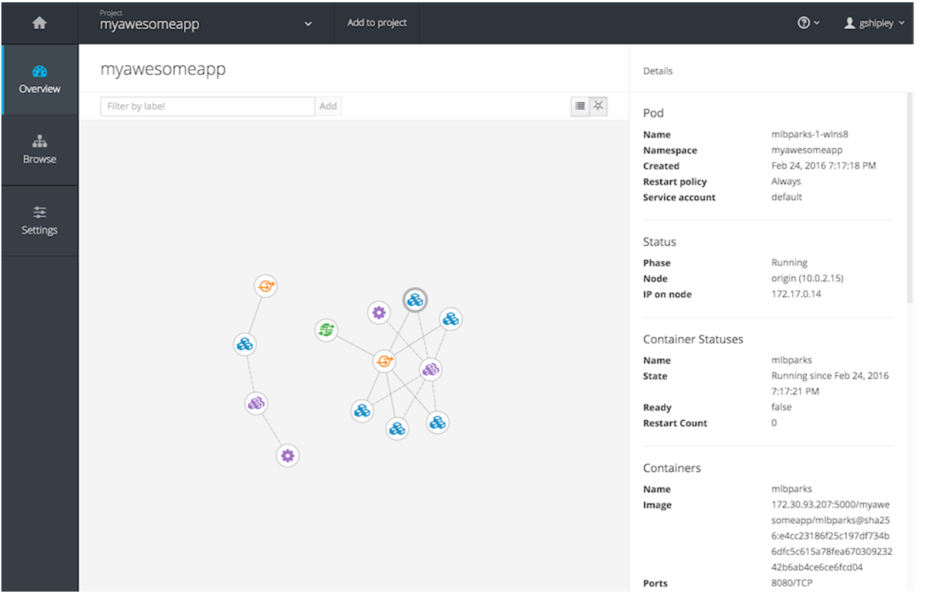
Features of OpenShift
Additional features in Web console
Graphical representation of an application that consists of multiple containers, load balancing, databases, mounts, etc. – all in one graph
Agile Brains Consulting
7
©Agile Brains Consulting Inc. All rights reserved. Not to be reproduced without prior written consent.
Notes:
Additionally, pods can be tagged with a label for recommended scheduling advice

Slide 8
Features of OpenShift
Source-to-Image (S2I) - Open source project by the OpenShift team
No need to write dockerfiles or build Docker images
Works directly with source code (e.g. github URL)
Needs base image and CMD when container starts, rest is done by S2I
e.g. Scenario: Java app in Git, using maven build system, depends on Tomcat webserver.
S2I will download the base tomcat image, clone the repo, identify it as a maven project, run a maven build, take the artifact, creates a new docker image containing tomcat webserver and project artifact, deploy the build artifact and start the container
Agile Brains Consulting
8
©Agile Brains Consulting Inc. All rights reserved. Not to be reproduced without prior written consent.
Notes:
Additionally, pods can be tagged with a label for recommended scheduling advice

Slide 9
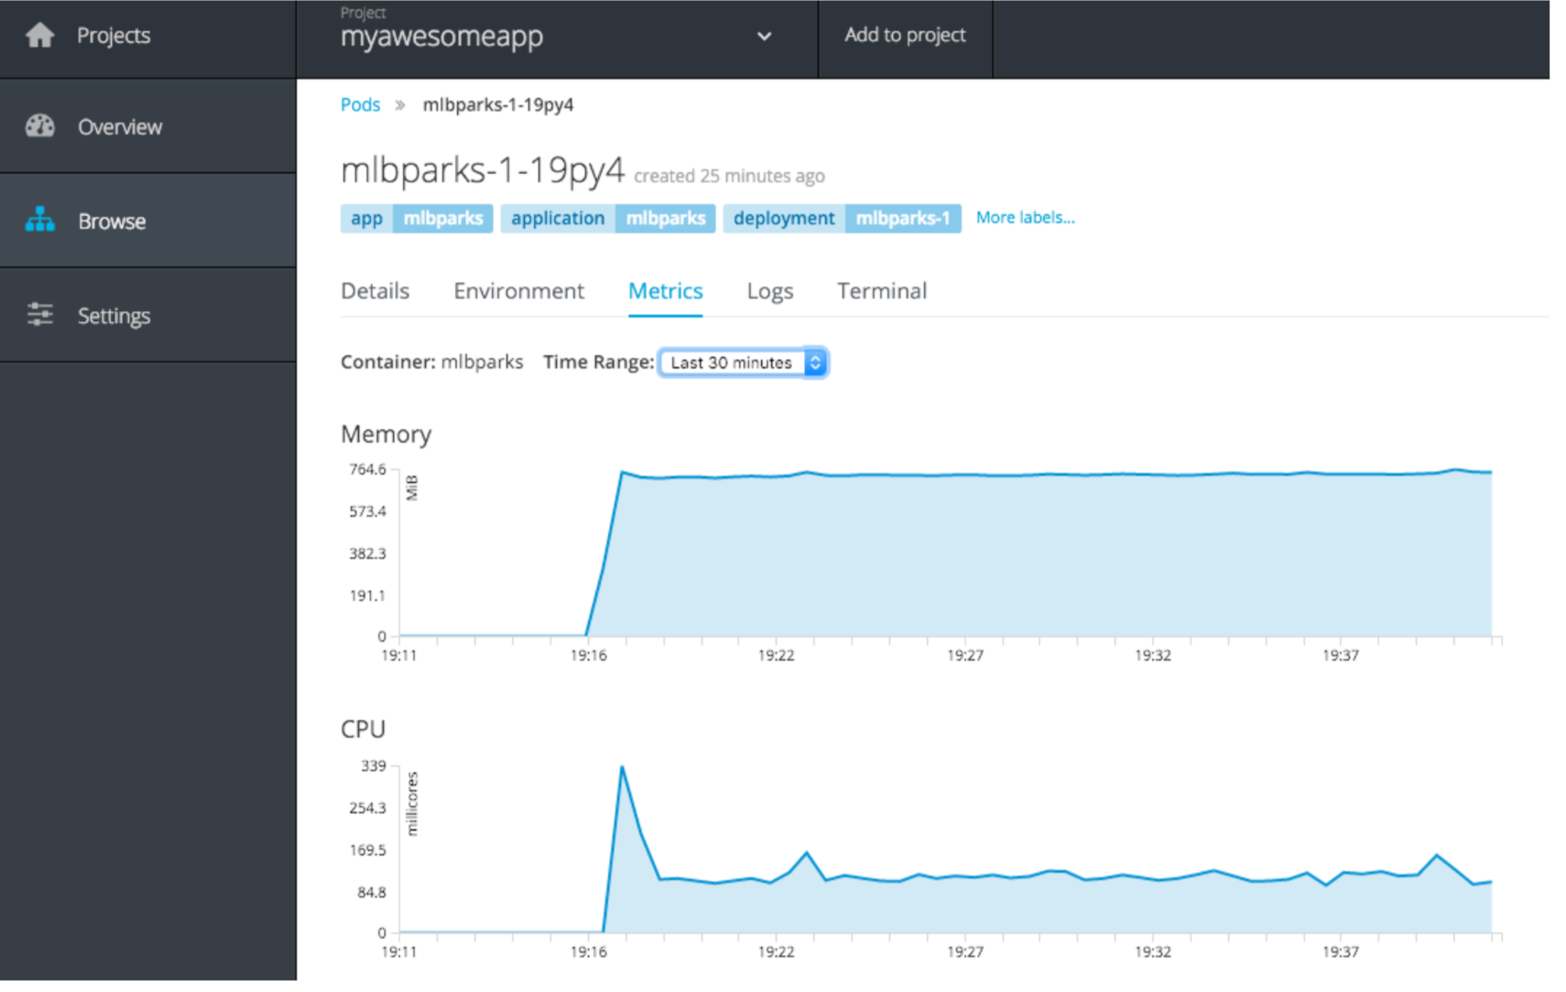
Features of OpenShift
Integrate logs and metrics
Logs:- OpenShift provides a comprehensive view of application logs – runtime logs, build logs, deployment logs – accessible using web-console and CLI
Metrics:- Application metrics, utilization of system resources, memory and CPU utilization for all containers
Agile Brains Consulting
9
©Agile Brains Consulting Inc. All rights reserved. Not to be reproduced without prior written consent.
Notes:
Additionally, pods can be tagged with a label for recommended scheduling advice

Slide 10
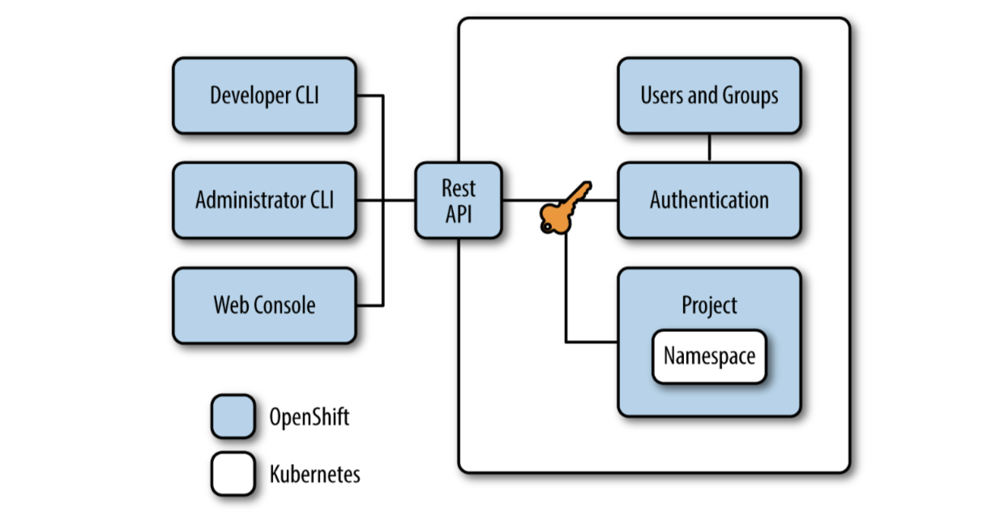
OpenShift “Projects”
Kubernetes use Namespace to divide cluster resources between multiple uses. There is no security between namespaces, Being a user in k8s cluster, you can see all namespaces.
Project
Project wraps a namespace, with access controlled through an authentication model
Users can only see and access what they are allowed to
Enables multitenant

Slide 11
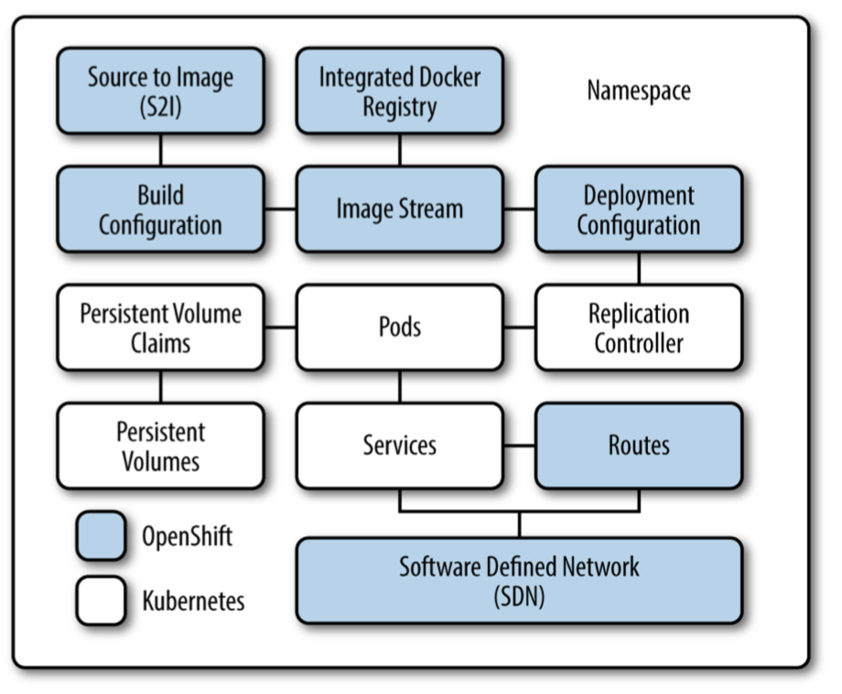
OpenShift “Applications”
OpenShift has no formal concept of an Application. It’s flexible based on need.
Fig. different parts goes in for an application
Build configuration: description of how to build source code. It can be either S2I or directly a docker image
Image stream: Tracks Docker image and it’s versions. You can refer to an existing Docker registry, if present
Deployment configuration: defines the template for a pod and manages deploying new images or configuration changes. All kinds of deployment strategy goes here and this creates replicationcontroller.

Slide 12
OpenShift Deployment and “DeploymentConfig”
Deployments provide management over common user applications, described using :
Deployment configuration, describes the desired state of a particular component of the application.
Replication controllers, which contain the state of a deployment configuration.
Pods
What’s different than Kubernetes Deployment ?
Triggers: drive the creation of new deployments in response to events, both inside and outside OpenShift.
Config change trigger – changes in replication controller template
Image change trigger
oc import-image foo --scheduled

Slide 13
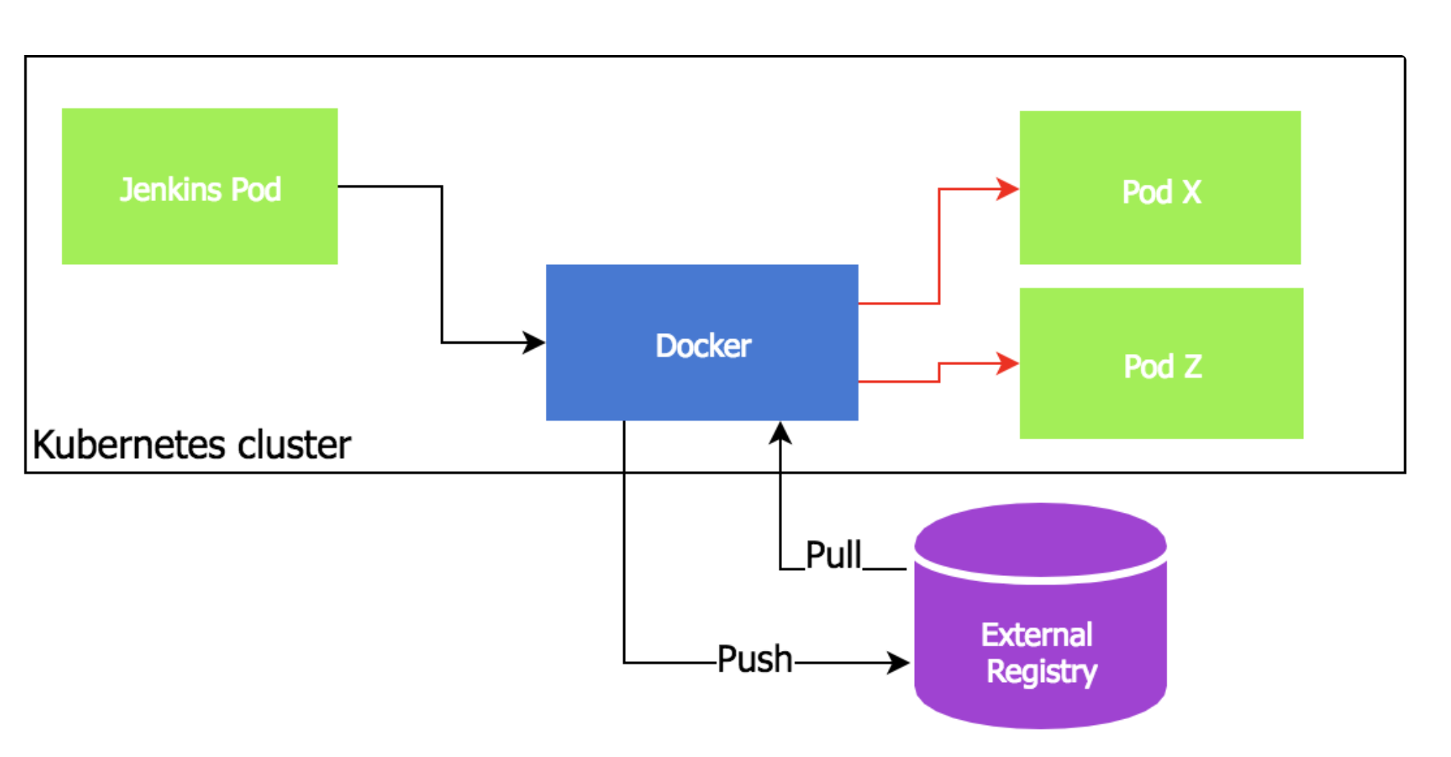
OpenShift “ImageStream”
Kubernetes requires to have an image registry to store images.
Need to expose docker socket directly to build agent (e.g. Jenkins) which is a security risk - this agent will be able to do anything with other containers running on the same host
Can we create images the same way as we create pods, replicasets and other resources?
K8s doesn’t have {image} resource unlike OpenShift.

Slide 14
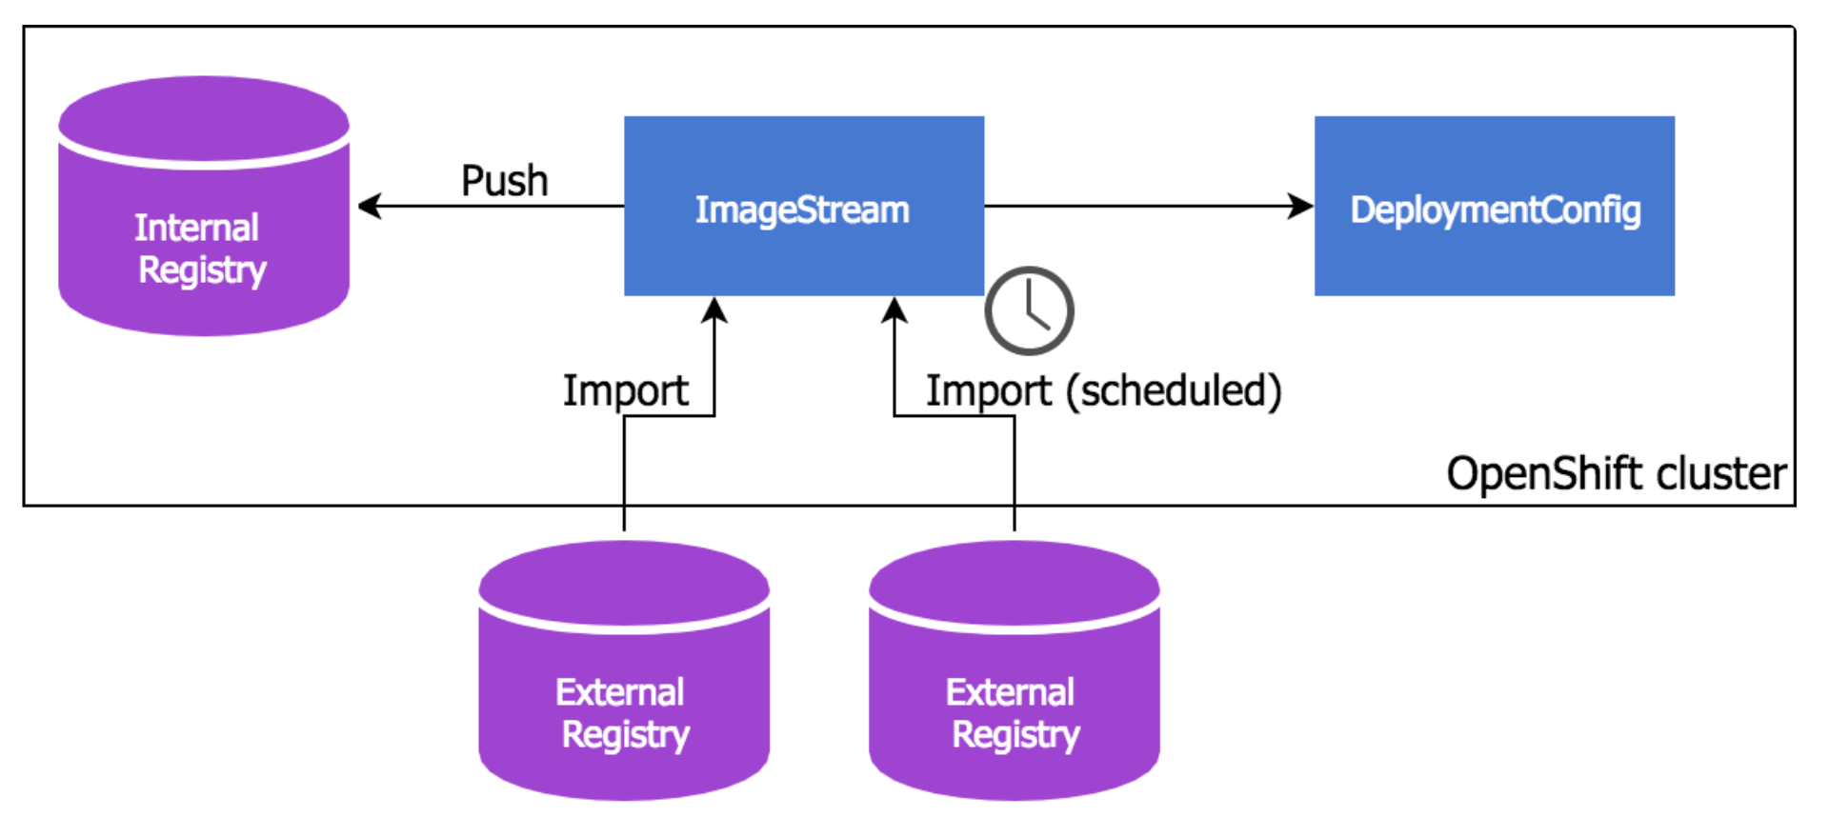
Manage Images with BuildConfig and “ImageStream”
fetch files from git repository
build a container image based on Dockerfile definition from that repo
push foo:latest built image to ImageStreamTag object
Image pushed to OpenShift internal registry
ImageStreamTags objects are references to individual container images kept in internal or external registries
apiVersion: v1
kind: BuildConfig
metadata:
name: foo-build
spec:
source:
git:
uri: "git@git.example.com:foo.git"
type: Git
strategy:
dockerStrategy:
noCache: true
output:
to:
kind: ImageStreamTag
name: foo:latest

Slide 15
OpenShift “Build” and “BuildConfig”
Build - Transform input parameters into a resulting object, mostly into a runnable container image.
BuildConfig - Config describing the strategy of a build. The build strategies are:
Source-to-Image (S2I)
Force Pull
Incremental
Pipeline - Jenkins pipeline for execution
Provide jenkinsfile in the build config
Provide jenkinsfile in a git repo and use git repo in the build config
Docker – Invokes Docker build, thus expects dockerfile with all required artifact
Provide Dockerfile
Provide docker image location

Slide 16
OpenShift Build Triggers
In BuildConfig, triggers can be defined to control the circumstances in which the BuildConfig should be run. The following build triggers are available:
Webhook - Trigger a new build by sending a request using push events from Github, GitLab, Bitbucket. In case of any change in Git repo, a new build will be created
Image Change – when a new image is found
Configuration Change – only when new BuildConfig is created. in future versions; updates in BuildConfig will also trigger a new build
Trigger can be set/removed
oc set triggers bc <name> --from-github
oc set triggers bc <name> --from-image='<image>'

Slide 17
OpenShift concept of “Routes”
Expose a service by giving it an externally-reachable hostname - www.example.com
Route and the endpoints is consumed by a router (HAProxy, F-5 are supported by default) to provide named connectivity that allows external clients to reach applications
Each route consists of a route name (max 63 characters), service selector, and (optional) security configuration.
oc expose svc/frontend --hostname=www.example.com --port 8080

Slide 18
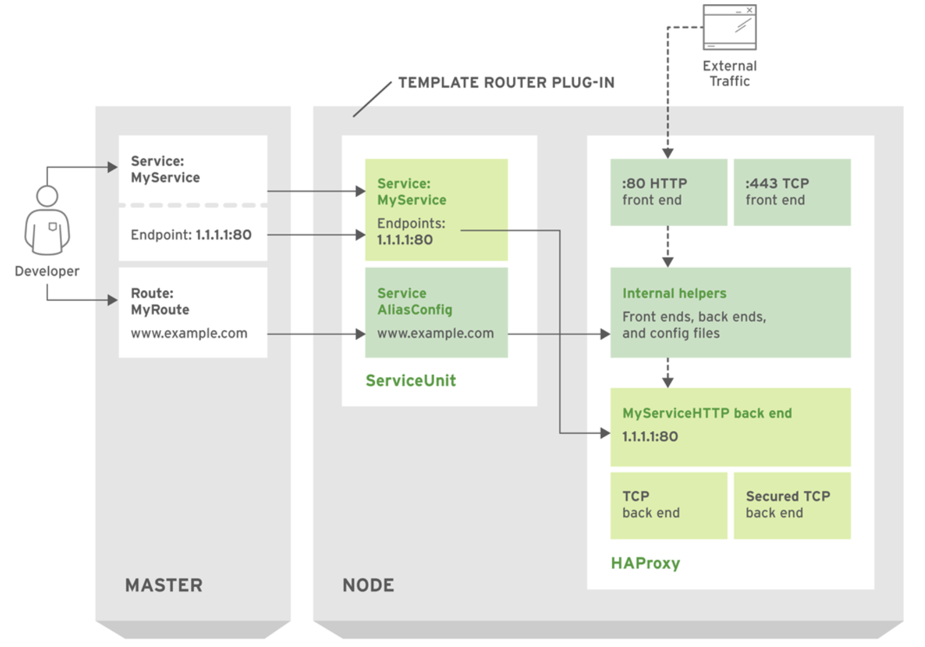
HAProxy Router Data Flow

Slide 19
OpenShift Online – labs
Agile Brains Consulting
19
©Agile Brains Consulting Inc. All rights reserved. Not to be reproduced without prior written consent.

Slide 20
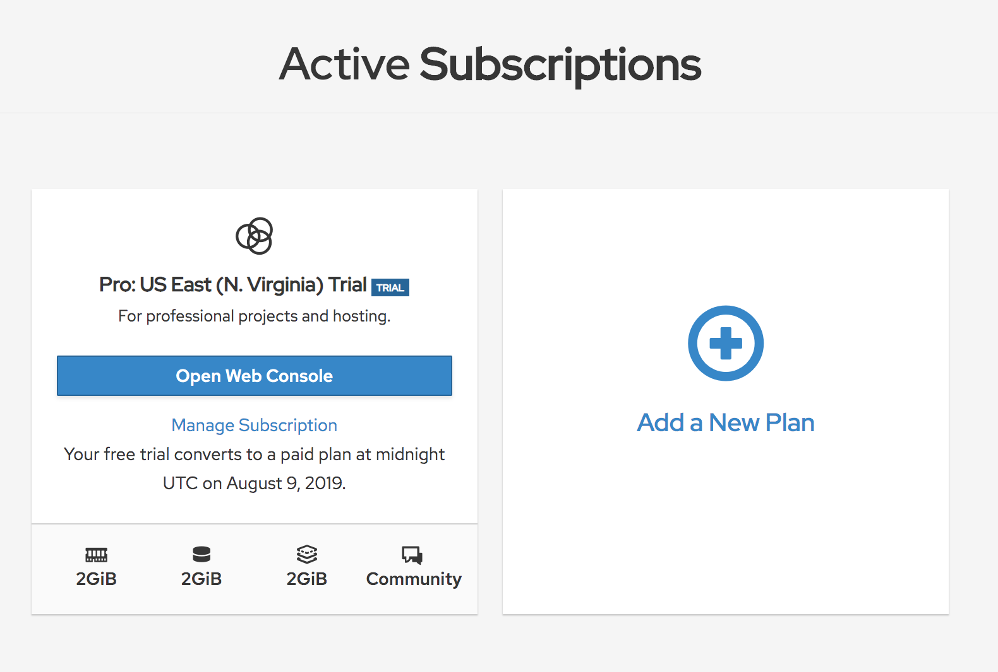
OpenShift Online Login
Login OpenShift Online at https://manage.openshift.com/
User id: osonline.test1@gmail.com
Password: JustM300
Open Web Console
This will take you to the web console of OpenShift cluster

Slide 21
OpenShift
- Web Console labs
Agile Brains Consulting
21
©Agile Brains Consulting Inc. All rights reserved. Not to be reproduced without prior written consent.

Slide 22
Ex 1: Deploy Application – Web Console (Using Image)
Steps to execute
Steps:
Create project <your-name>-firstproject
Deploy from image – with image "openshiftroadshow/parksmap-katacoda:1.2.0"
Scale up pod; Check logs; Check events
Check Image Stream
Create route to expose external service

Slide 23
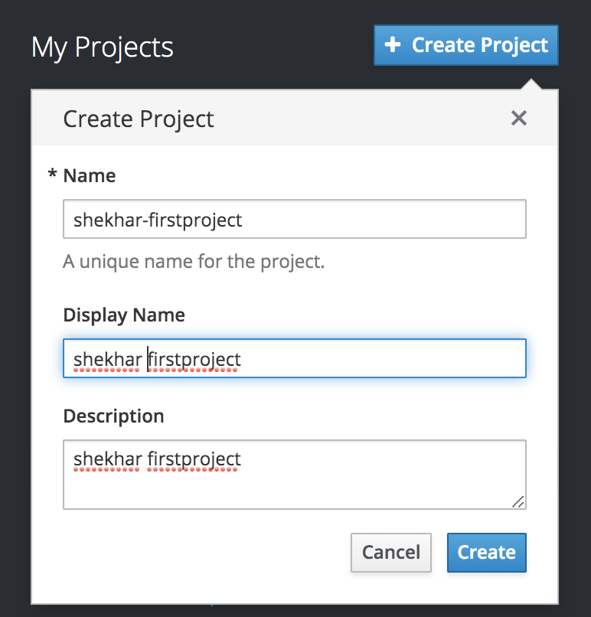
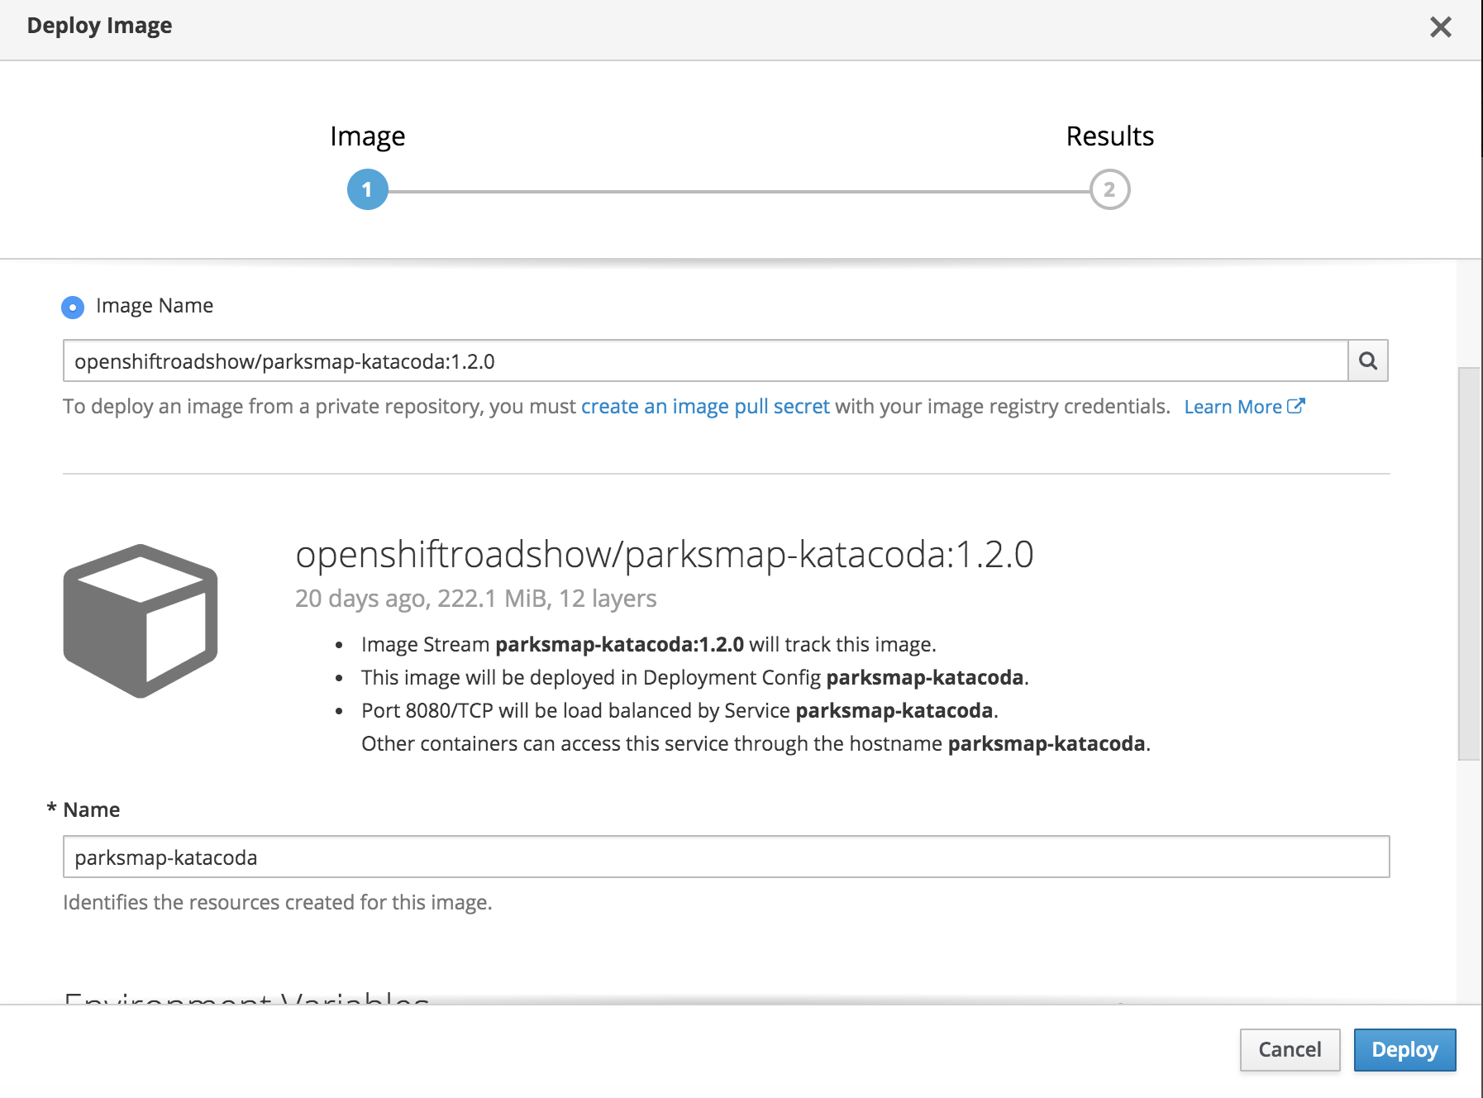
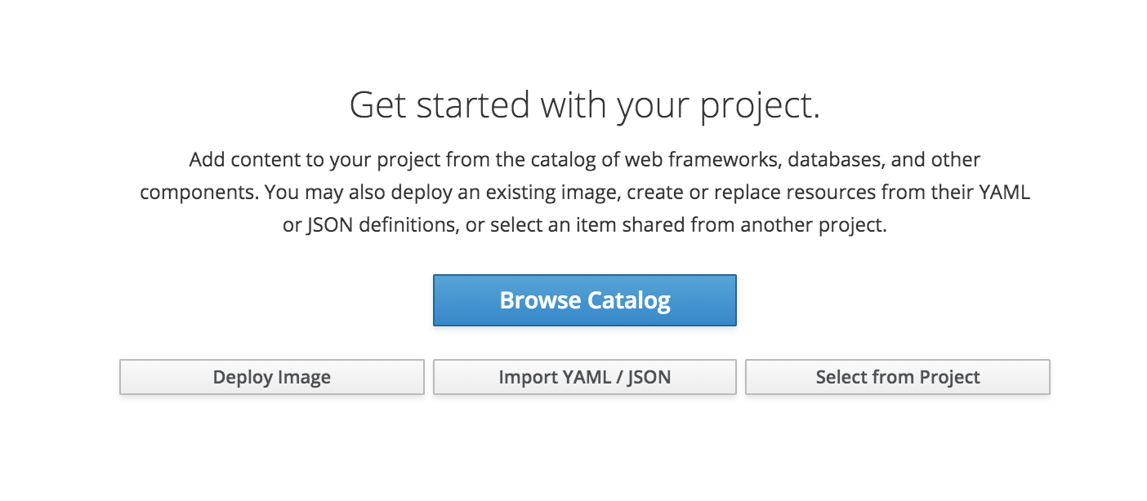
Ex 1: Deploy Application – Web Console (Using Image)
Steps in UI

Slide 24
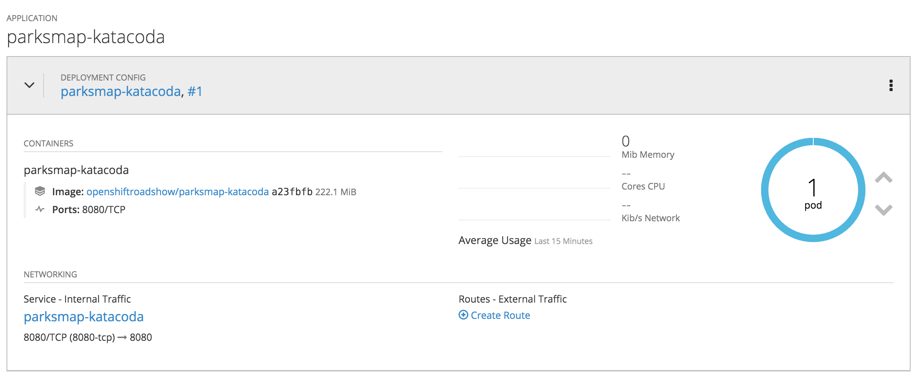
Ex 1: Deploy Application – Web Console (Using Image)
Project overview

Slide 25
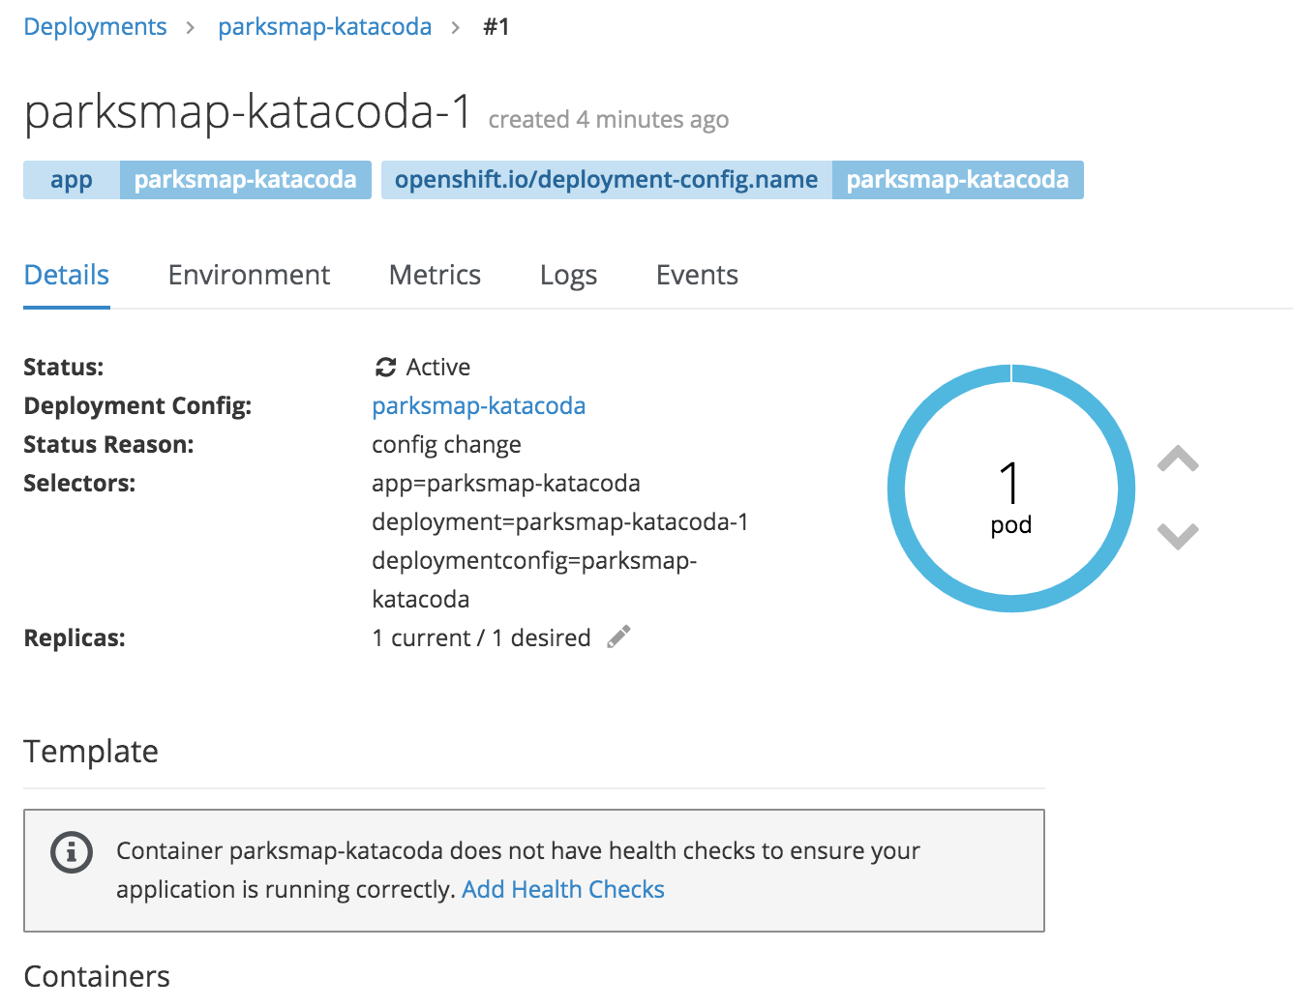
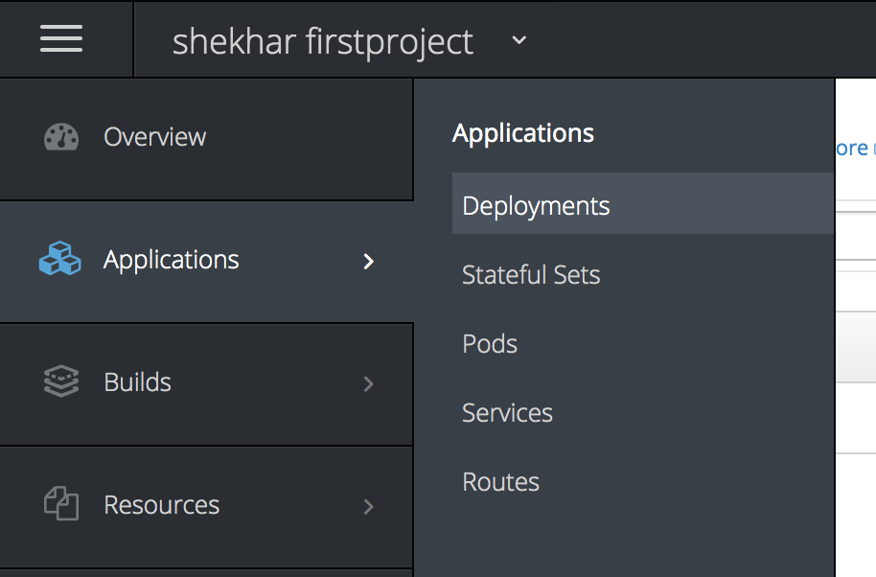
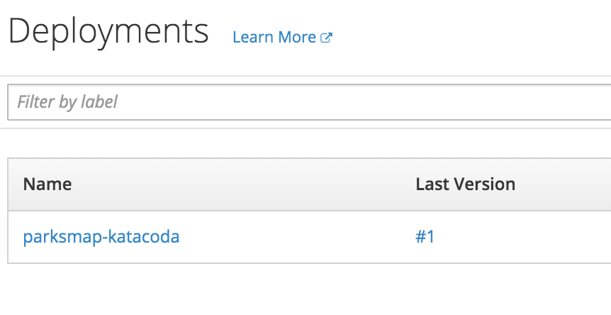
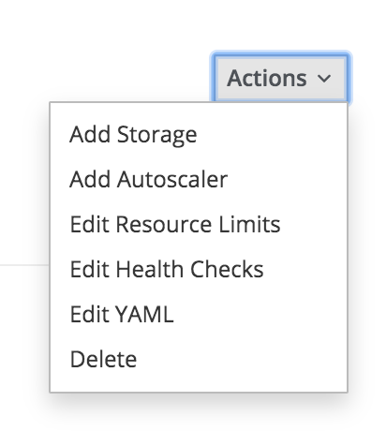
Ex 1: Deploy Application – Web Console (Using Image)
Deployment
Logs
Events
Scale up/down pods

Slide 26
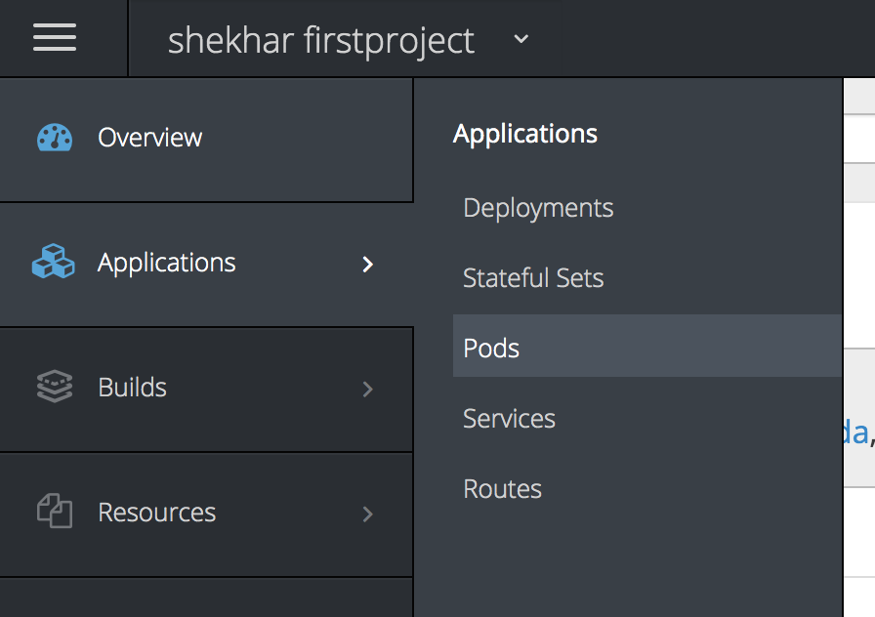
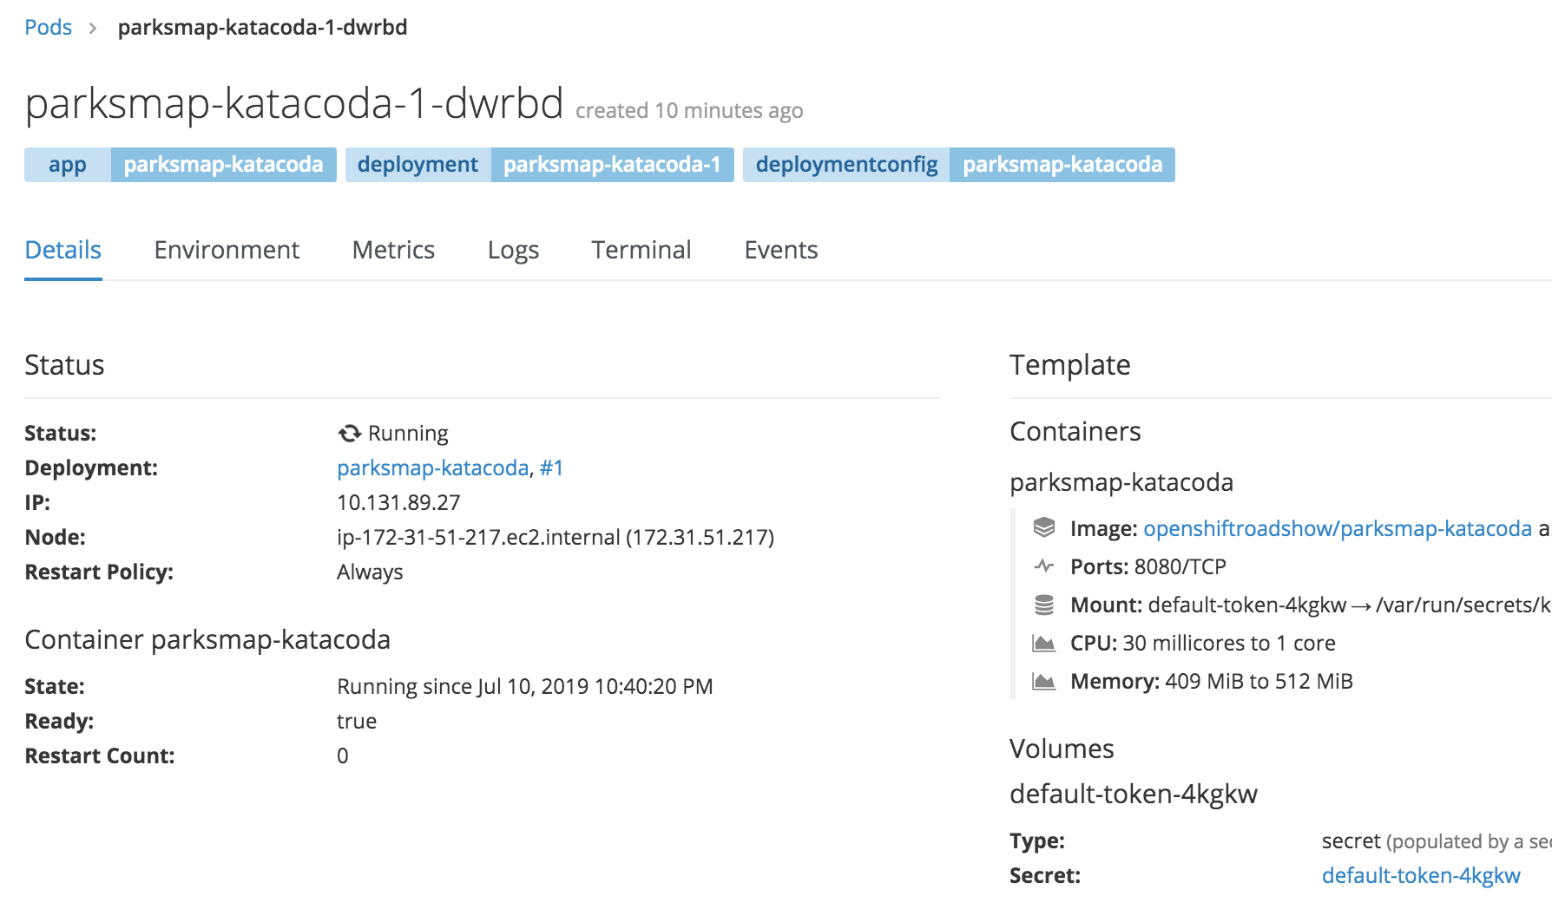
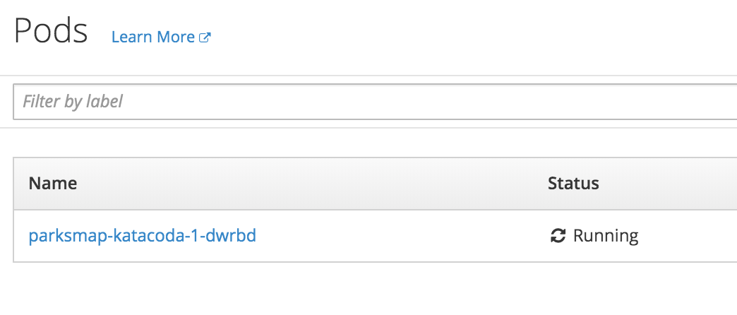
Ex 1: Deploy Application – Web Console (Using Image)
Pods

Slide 27
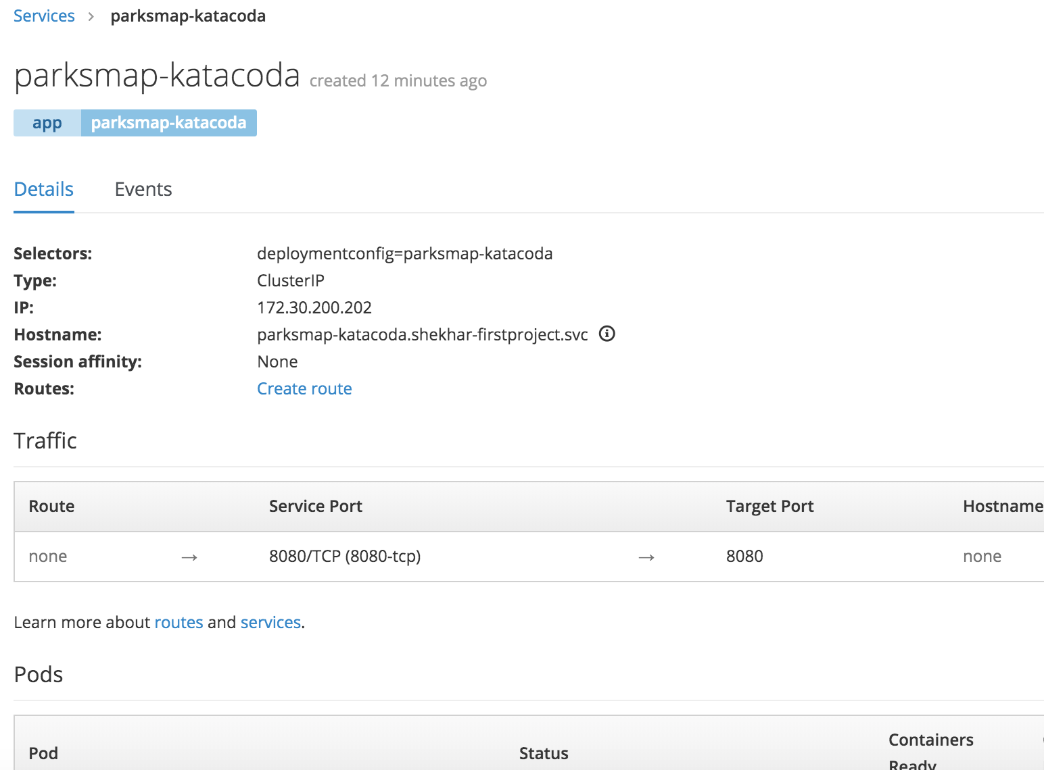
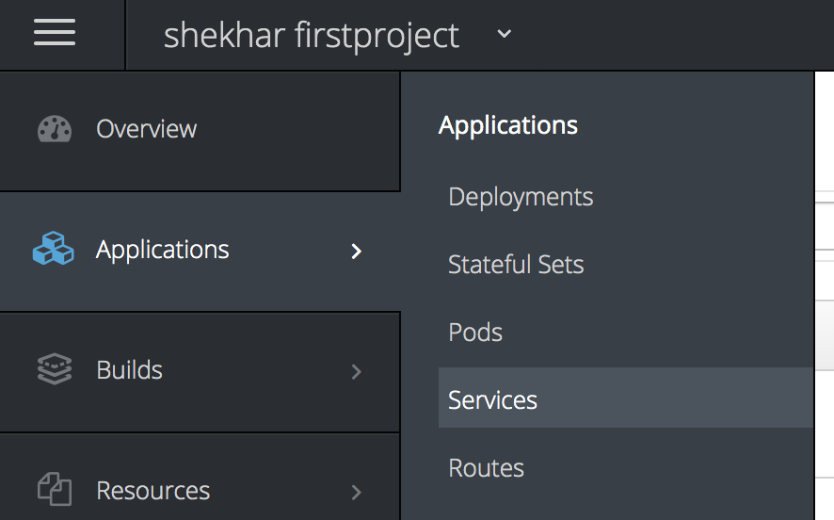
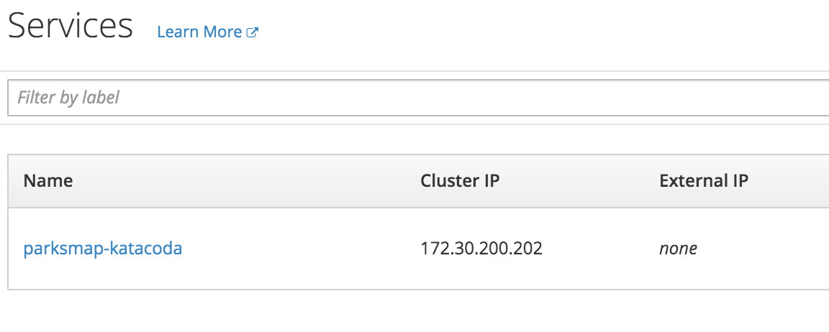
Ex 1: Deploy Application – Web Console (Using Image)
Service
Note:- Check routes, there might be no routes

Slide 28
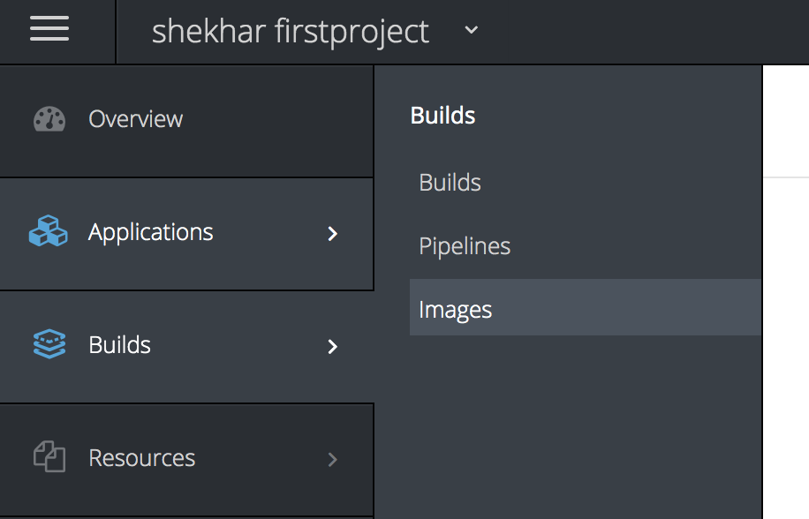
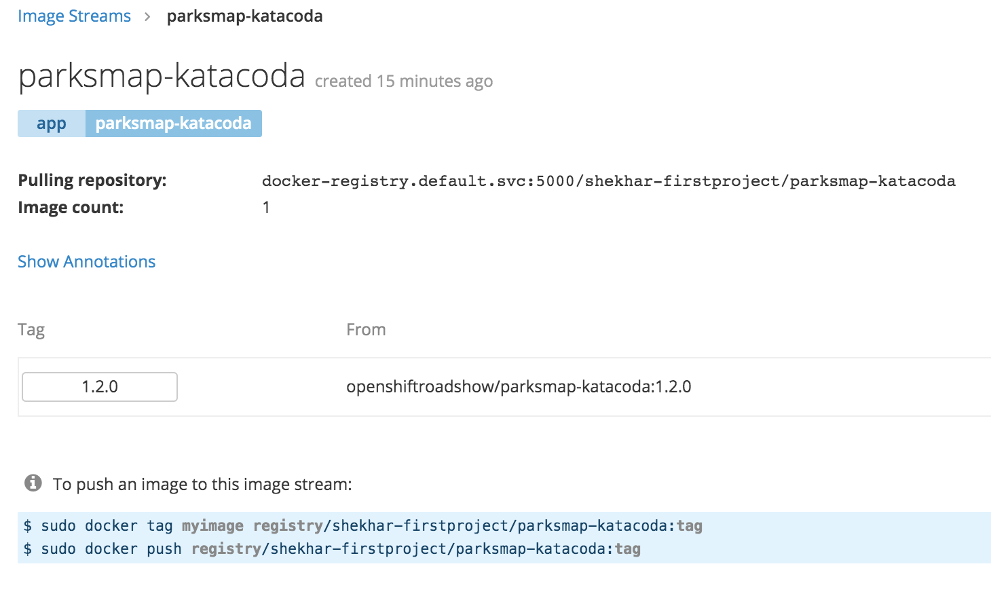
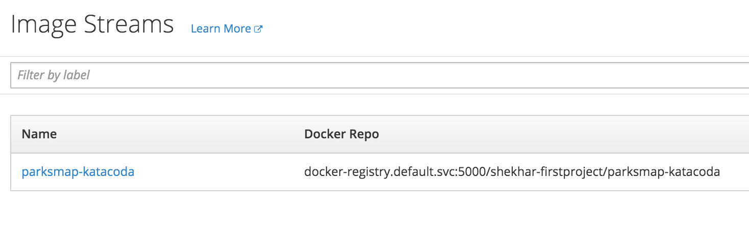
Ex 1: Deploy Application – Web Console (Using Image)
Image Stream

Slide 29
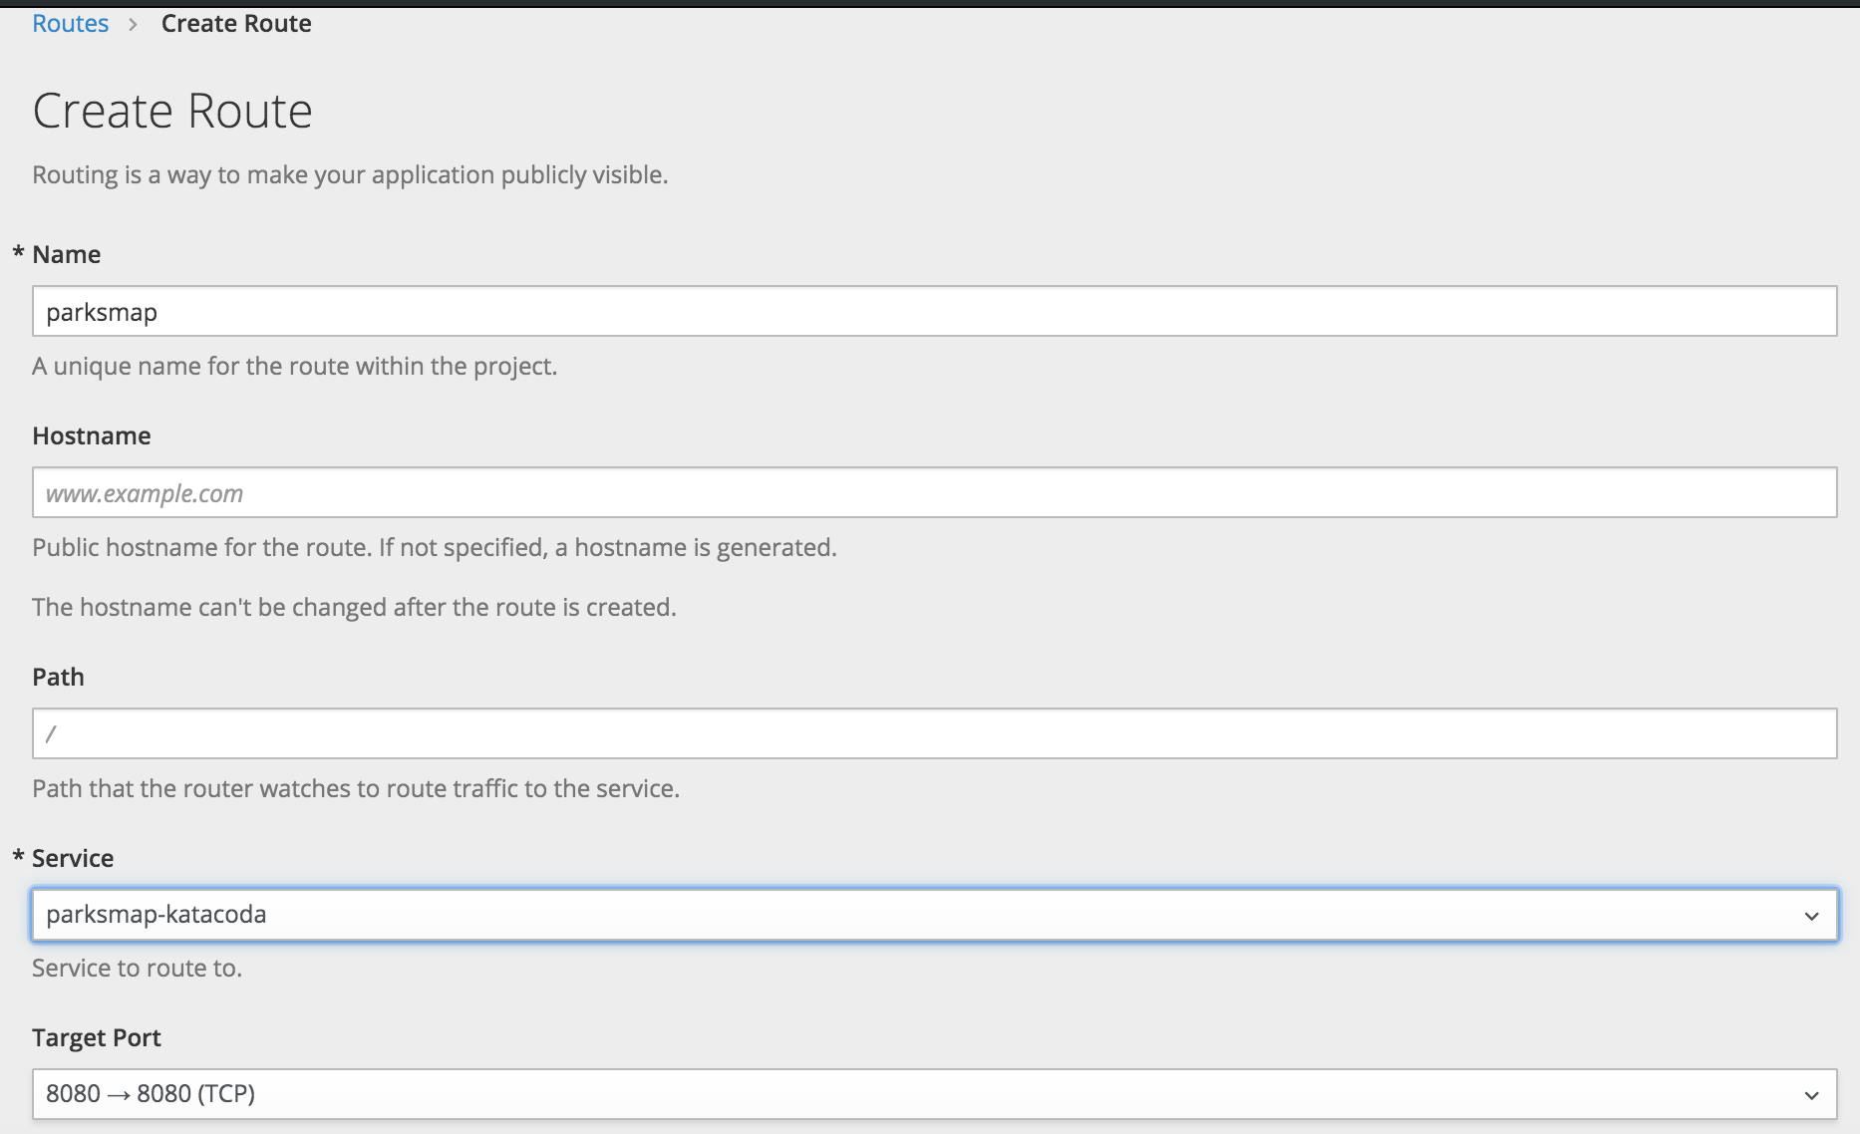
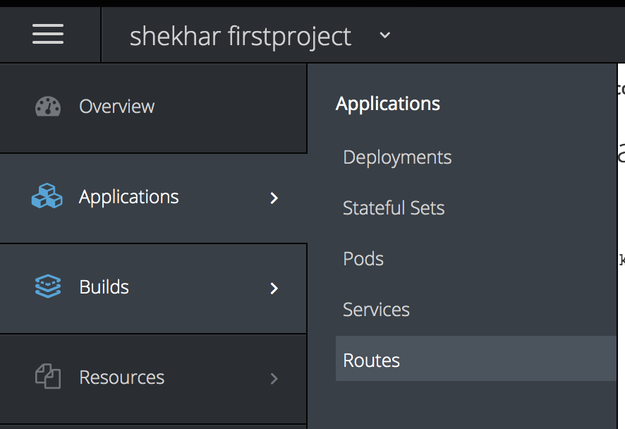
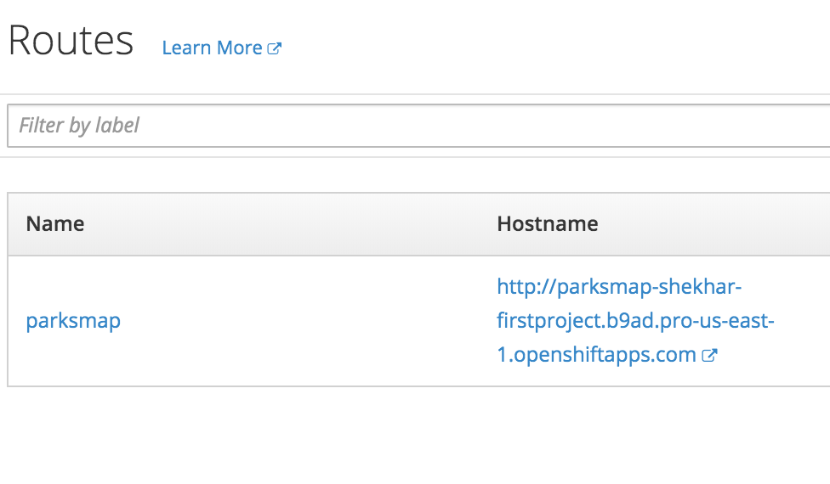
Ex 1: Deploy Application – Web Console (Using Image)
Create Route
URL to access

Slide 30
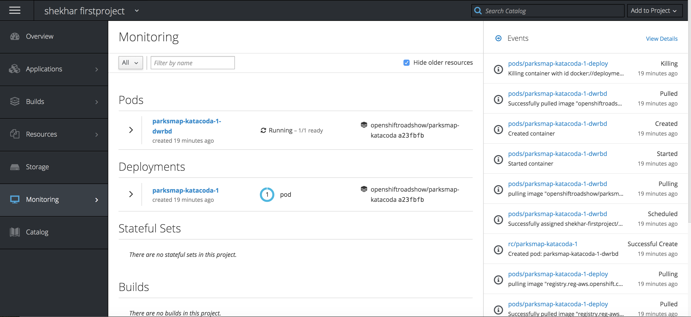
Ex 1: Deploy Application – Web Console (Using Image)
Monitoring and Events

Slide 31
Ex 2: Deploy Application – Web Console (Using S2I)
Steps to execute
Steps:
Use the same project <your-name>-firstproject
Add --> browse catalog --> select Python --> create application
Change Python version to 3.5 ; Provide name “nationalparks-katacoda”
Provide Git repo “https://github.com/openshift-roadshow/nationalparks-katacoda”
Scale up pod; Check logs; Check events
Check Build; Check build config
Check Image Stream
Create route to expose external service

Slide 32
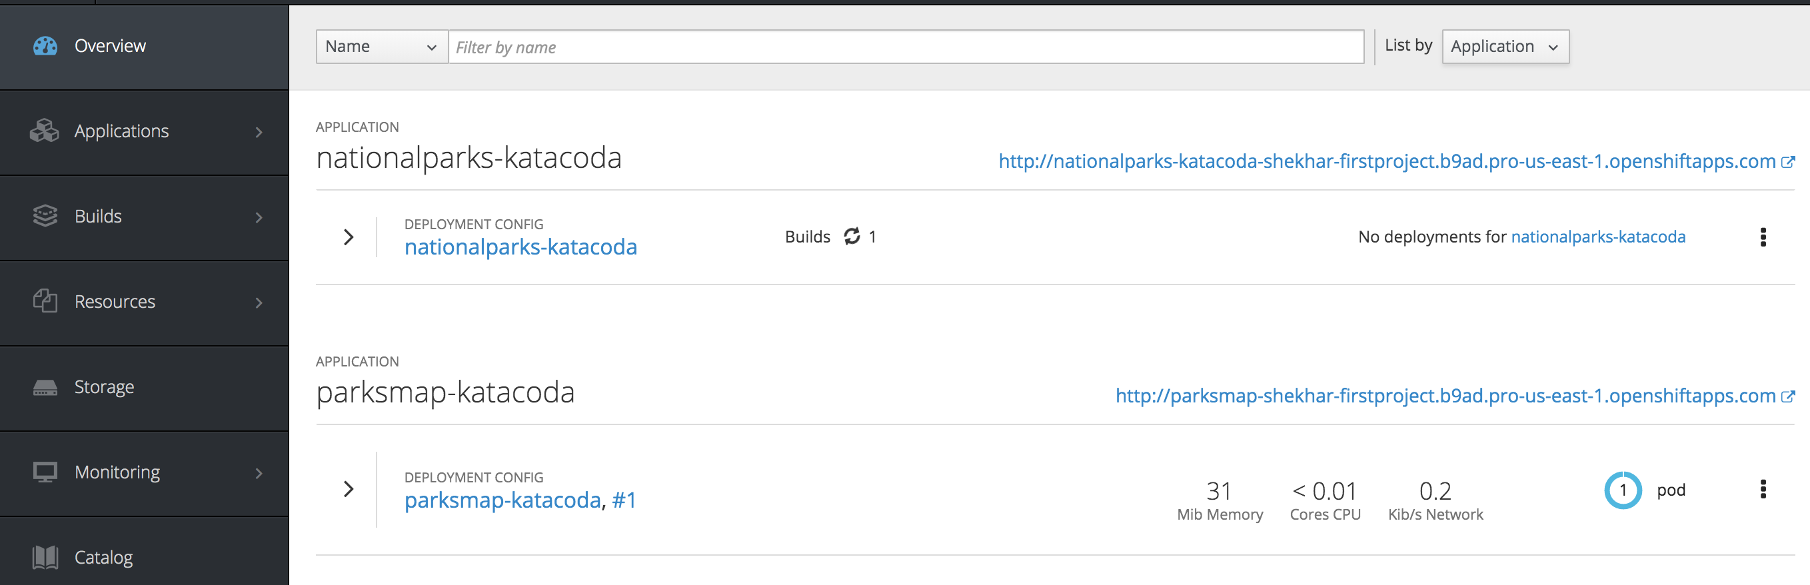
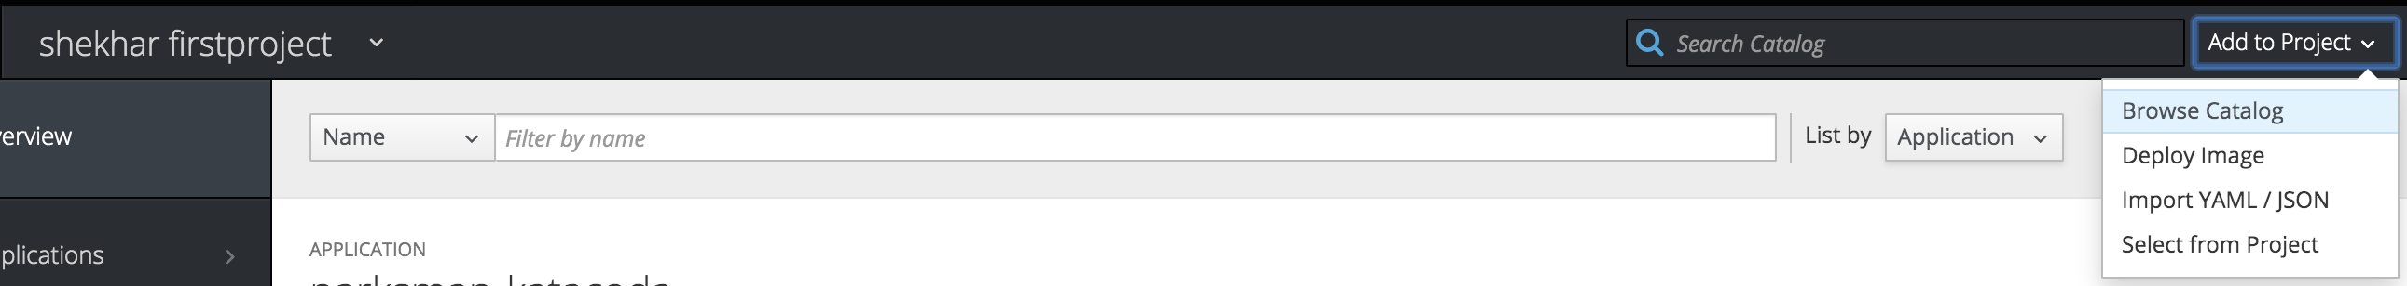
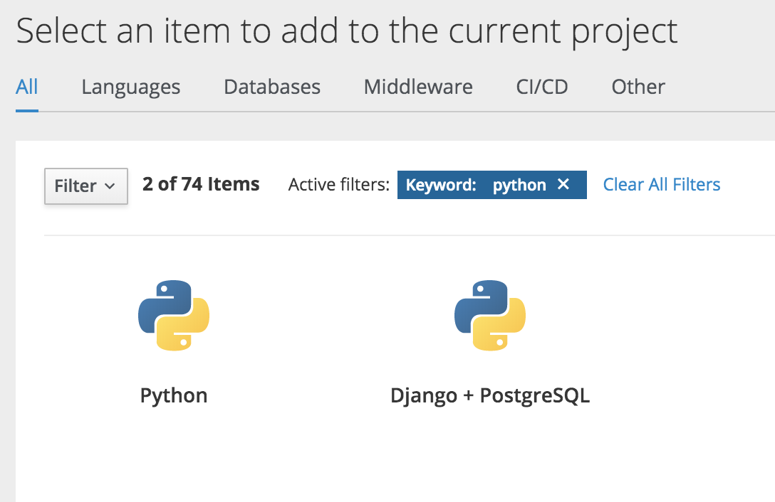
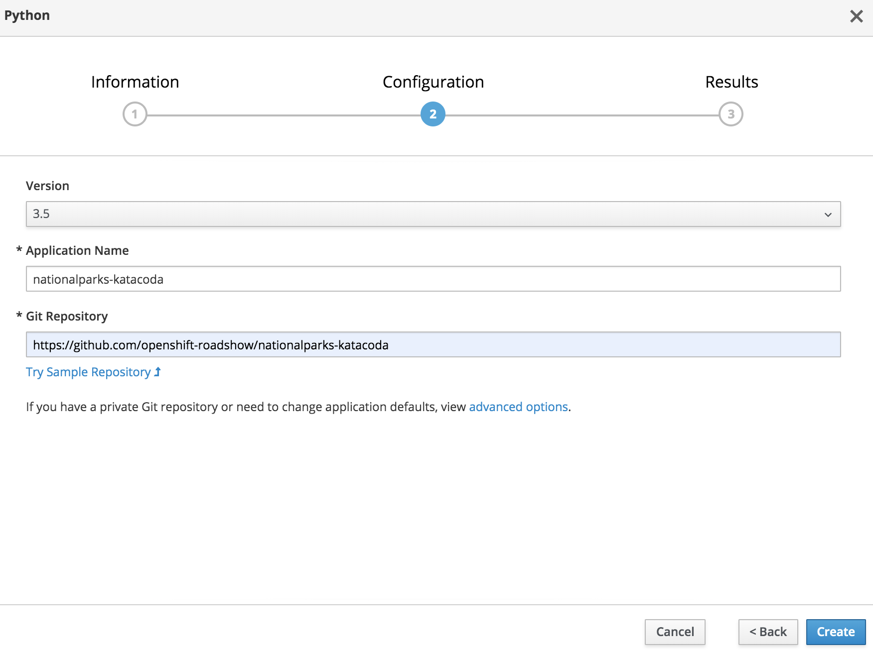
Ex 2: Deploy Application – Web Console (Using S2I)
Steps in UI

Slide 33
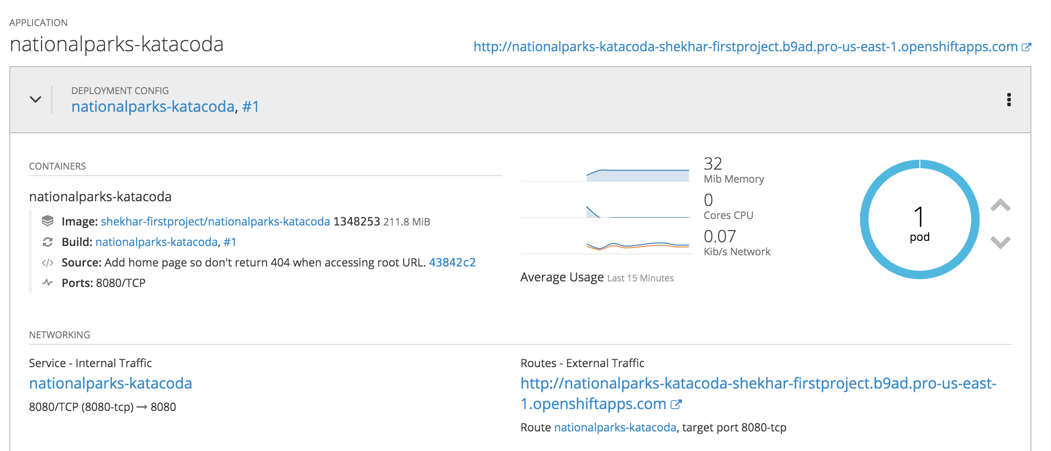
Ex 2: Deploy Application – Web Console (Using S2I)
Project overview

Slide 34
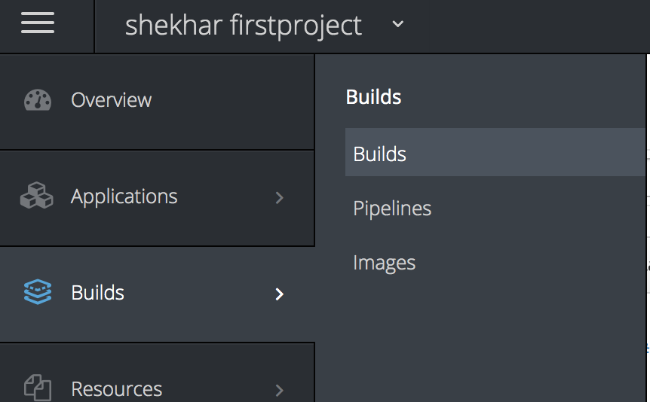
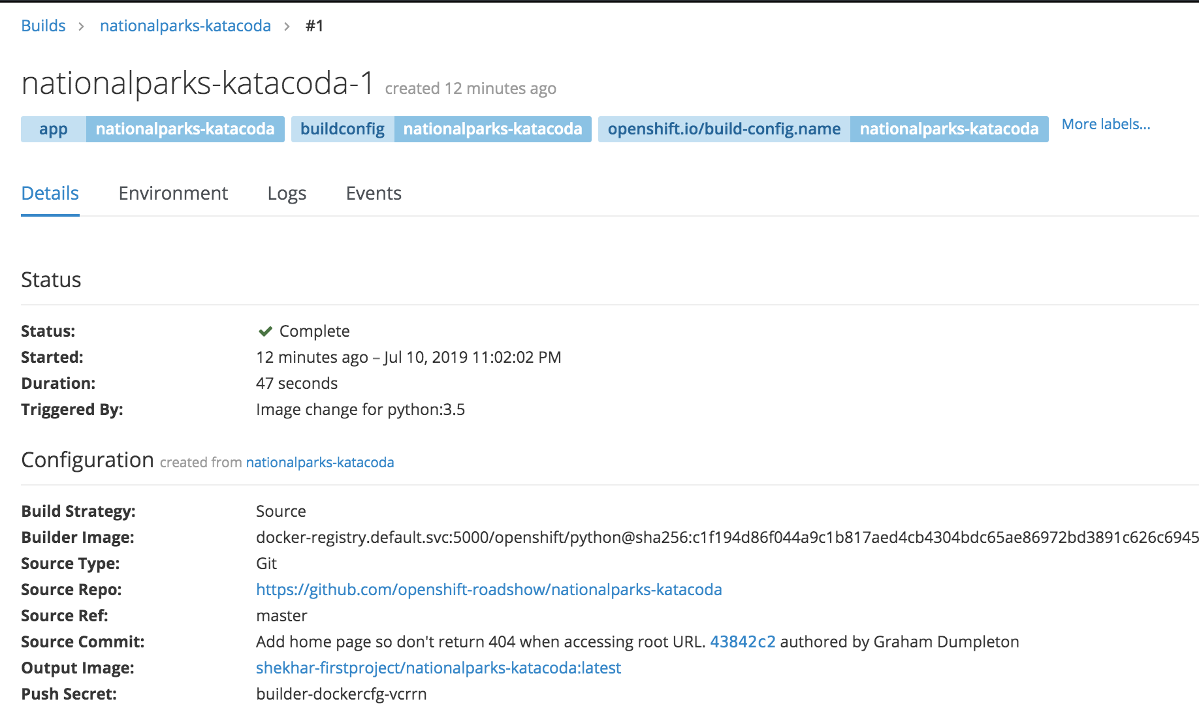
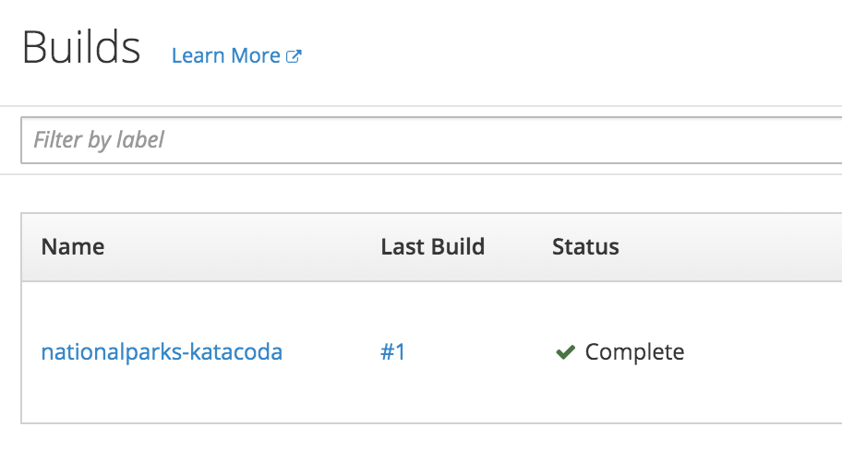
Ex 2: Deploy Application – Web Console (Using S2I)
Build

Slide 35
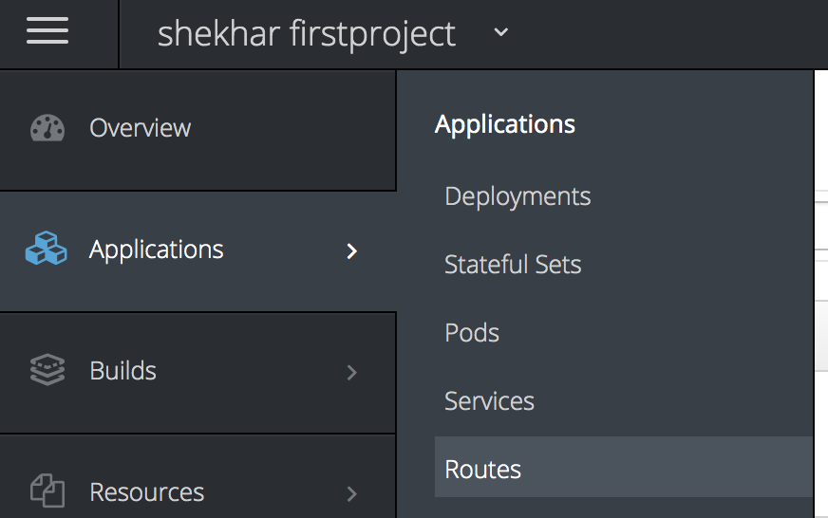
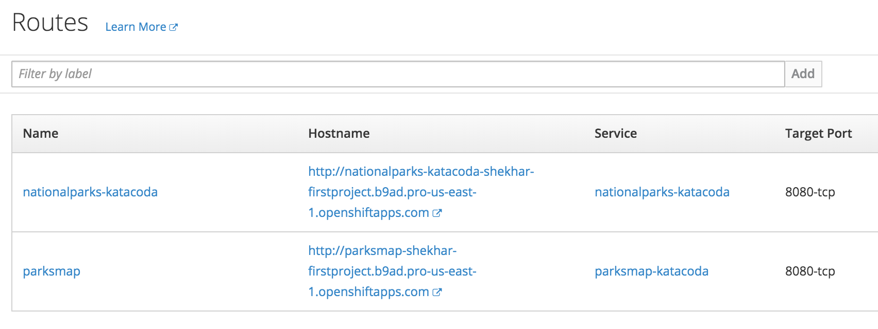
Ex 2: Deploy Application – Web Console (Using S2I)
Route
Route auto created

Slide 36
Clean up
Delete the projects to save on limited resources

Slide 37
OpenShift – OC CLI labs
Agile Brains Consulting
37
©Agile Brains Consulting Inc. All rights reserved. Not to be reproduced without prior written consent.

Slide 38
OpenShift OC Install
OC CLI: Download the {command-line tool}, un-tar it and add to the {path}
https://github.com/shekhar2010us/kubernetes_teach_git/blob/master/openshift/openshift_oc_cli_download.md

Slide 39
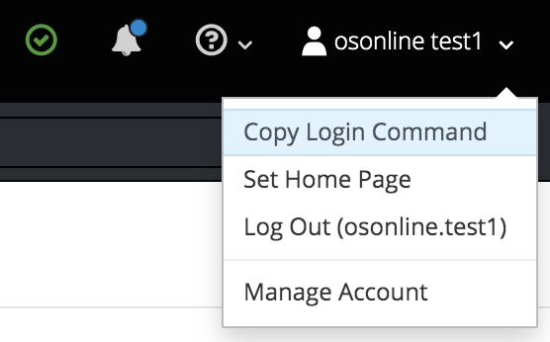
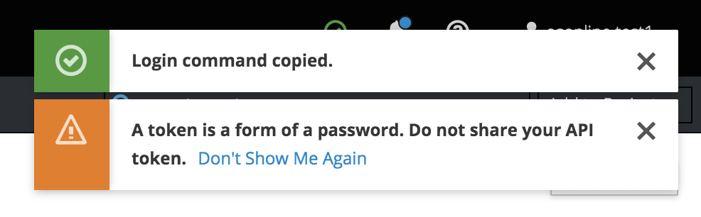
OpenShift OC Login
Login token: In the top right corner, click “Copy Login Command”. This will bring the login token
Format: oc login <url> --token=<token>
CLI Login: In a terminal, paste the above command to login to the OpenShift online Cluster

Slide 40
Ex 3: Deploy Application – CLI (Using Image)
Steps:
Create a new project <your-name>-secondproject
Create app for deploying with image – "openshiftroadshow/parksmap-katacoda:1.2.0"
Scale up pod; Check logs; Check events
Check Image Stream
Create route to expose external service
https://github.com/shekhar2010us/kubernetes_teach_git/blob/master/openshift/openshift_oc_ex3_docker-image.md

Slide 41
Ex 4: Deploy Application – CLI (Using S2I)
Steps:
Create a new project <your-name>-secondproject
Create an App using S2I --> using Wildfly 10.0
Provide name “openshift-helloworld”
Fork the git https://github.com/shekhar2010us/openshift-helloworld.git
Provide Git repo “<your forked repo>”
Scale up pod; Check logs; Check events
Check Build; Check build config
Check Image Stream
Create route to expose external service
https://github.com/shekhar2010us/kubernetes_teach_git/blob/master/openshift/openshift_oc_ex4_s2i.md

Slide 42
Ex 5: Deployment using Webhook
Steps:
Use the existing project <your-name>-secondproject
Find the webhook URI for your particular application
Add webhook in your git project
Make changes, push to git, these changes will trigger a new build
https://github.com/shekhar2010us/kubernetes_teach_git/blob/master/openshift/openshift_oc_ex5_webhook.md

Slide 43
Clean up
Delete the projects to save on limited resources

Slide 44
Application Template
Describes a parameterized set of objects to produce a list of objects for creation.
The objects to create can include anything that users have permission to create.
May also define a set of labels to apply to every object defined in the template.
What a templates contains:
A set of resources, set of values and matching label
Scope of templates:
Global or local to projects
Notes:
https://blog.openshift.com/part-2-creating-a-template-a-technical-walkthrough/

Slide 45
Ex 6: Application Template
The application template we will be using will create a full Java EE application and a MongoDB database that will perform geospatial queries to update a map via REST endpoints.
https://github.com/shekhar2010us/kubernetes_teach_git/blob/master/openshift/openshift_oc_ex6_templates.md
Ref: https://blog.openshift.com/part-2-creating-a-template-a-technical-walkthrough/

Slide 46
Clean up
Delete the projects to save on limited resources

Slide 47
References
Agile Brains Consulting
47
©Agile Brains Consulting Inc. All rights reserved. Not to be reproduced without prior written consent.

Slide 48
OpenShift CLI Reference:
https://docs.openshift.com/enterprise/3.0/cli_reference/basic_cli_operations.html#object-types
OpenShift Rest Reference:
https://docs.openshift.com/container-platform/3.6/rest_api/openshift_v1.html
OpenShift Rest JAVA Reference:
https://github.com/openshift/openshift-restclient-java
OpenShift Rest Python Reference:
https://github.com/openshift/openshift-restclient-python
https://docs.openshift.com/container-platform/3.7/rest_api/index.html#rest-api-example-python
OpenShift Online Trial
https://www.openshift.com/trial/
OpenShift Online Trial – Web Console
https://manage.openshift.com/account/index

